Slide 1
Deepfake Image Detection using Frequency-Domain Features
Candidate’s Name:
Supervisors’ Name:
Notes:
Good morning/afternoon everyone. My name is , and today I will be presenting my research proposal titled "Deepfake Image Detection using Frequency-Domain Features." This research investigates whether analysing images in the frequency domain can improve the detection of AI-generated deepfake images compared with traditional image analysis techniques.

Slide 2
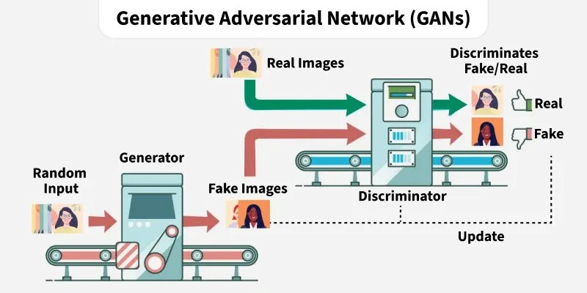
Background: Rise of AI-Generated Media
Advances in AI/deep learning (GANs: generator + discriminator) now produce highly realistic synthetic images and video
Increasing difficulty distinguishing genuine from AI-generated content (Pei et al., 2026)
Deepfakes media altered via GANs/autoencoders widely used in entertainment, VR, and social media
Easy access to deepfake tools has enabled misuse without technical expertise
Figure: A generic GAN architecture
(GeeksforGeeks, 2019)
Notes:
Deepfake technology has advanced rapidly due to developments in artificial intelligence, especially Generative Adversarial Networks or GANs. These models can create highly realistic fake images that are often difficult for humans to distinguish from genuine ones.

Slide 3
Risks and the Need for Detection
Malicious use: disinformation, identity theft, political manipulation, digital fraud
Rapid viral spread on social media amplifies societal harm
Erosion of trust in digital information sources
Growing need for automated, reliable detection systems in cybersecurity, digital forensics, and media verification (Sunil et al., 2025).
Notes:
While deepfakes have useful applications in entertainment and virtual reality, they are increasingly misused for misinformation, identity theft, political manipulation, and online fraud. Therefore, reliable automated detection methods have become essential.

Slide 4
Research Problem & Gap
Limitations of Existing Detection Approaches
Traditional detectors rely on spatial-domain (pixel-level) analysis texture, lighting, facial inconsistencies
As GANs improve, visual artefacts become imperceptible spatial methods lose reliability
Existing systems struggle to generalise across datasets/generation techniques and are sensitive to compression/resolution changes (Sohail et al., 2025).
Gap
Frequency-domain analysis (FFT/DCT) can reveal hidden spectral artefacts invisible in the spatial domain , an under-explored, more robust alternative (Sohail et al., 2025).
Notes:
Most existing deepfake detection systems analyse images in the spatial domain by looking for visible inconsistencies such as lighting, facial textures, or image artefacts.
However, modern GANs generate increasingly realistic images where these visual clues are almost invisible. My research addresses this limitation by investigating frequency-domain analysis, which can reveal hidden spectral patterns that are difficult to observe in normal images.

Slide 5
Research Aim & Objectives
Aim
This research aims to develop a deepfake image detection system using frequency-domain features to identify hidden spectral artefacts and improve detection accuracy compared with traditional spatial-domain detection methods.
Objectives
To test the Deepfake and Real Images dataset on the detection model training and testing.
To convert images in the spatial domain to the frequency domain by using Fast Fourier Transform (FFT) and Discrete Cosine Transform (DCT).
To learn informative frequency-domain features that reflect spectral anomalies in deepfake pictures.
To learn machine learning models to determine real or fake images.
To assess the performance of models in terms of standard measures: accuracy, precision, recall and F1-score.
To compare the performance of frequency-domain detection to the conventional methods in space.
Notes:
The main aim of this research is to develop a deepfake image detection system using frequency-domain features.
To achieve this, I will use a publicly available dataset, transform images using FFT and DCT, extract frequency features, train machine learning and deep learning models, evaluate their performance using standard metrics, and compare them with traditional spatial-domain methods.

Slide 6
Research Questions & Scope
Can frequency-domain analysis effectively detect deepfake images by identifying hidden spectral artefacts that are not visible in spatial-domain representations?
What specific spectral cAharacteristics or frequency patterns distinguish real images from deepfake-generated images?
How effectively do machine learning models perform when trained using frequency-domain features for deepfake image classification?
Does frequency-domain analysis improve detection accuracy, robustness, and generalisation compared to traditional spatial-domain deepfake detection methods?
Scope:
Focus: static facial images (not video andaudio deepfakes, not real-time detection)
Dataset: Kaggle "Deepfake and Real Images"
Tools: FFT, DCT, Python-based ML/DL models
Notes:
The research focuses on four main questions.
First, whether frequency-domain analysis can effectively detect deepfake images.
Second, which spectral characteristics distinguish real and fake images.
Third, how well machine learning models perform using frequency features.
Finally, whether frequency-domain methods outperform traditional spatial-domain approaches.
The scope is limited to static facial images from the Kaggle Deepfake and Real Images dataset.

Slide 7
Significance & Contributions
Significance
Academic: extends deepfake detection/digital forensics research via frequency-domain analysis
Technological: supports development of AI-based forensic verification tools
Societal: helps counter misinformation, identity theft, and reputational harm (Alzahrani, 2024).
Key Contributions
A frequency-domain detection framework
Comparative analysis of spatial vs. frequency-domain features
Evaluation across multiple ML/deep learning classifiers
Foundation for future deepfake detection research
Notes:
This research contributes academically by extending research in digital image forensics.
Technologically, it proposes a frequency-domain detection framework and compares multiple machine learning and deep learning models.
From a societal perspective, the research supports efforts to reduce misinformation, identity theft, and online fraud caused by deepfakes.

Slide 8
Quantitative, Experimental Design
Quantitative, Experimental Design
Hypothesis: GAN-generated images contain frequency-domain artefacts not visible spatially
3×3 experimental grid: 3 architectures (Custom CNN, VGG16, ResNet50) × 3 input types (Spatial, FFT, DCT) = 9 experiments
Additional baseline: Logistic Regression on an 8-D FFT+DCT feature vector
Purely computational no human participants/surveys
Implemented in Python (Jupyter Notebook) on Google Colab (GPU-accelerated)
Notes:
This research follows a quantitative experimental design.
The hypothesis is that GAN-generated images contain hidden frequency artefacts that are not visible in the spatial domain.
I will conduct nine experiments using three neural network architectures-Custom CNN, VGG16, and ResNet50 across three different input types: spatial images, FFT images, and DCT images.
Additionally, Logistic Regression will serve as the baseline model

Slide 9
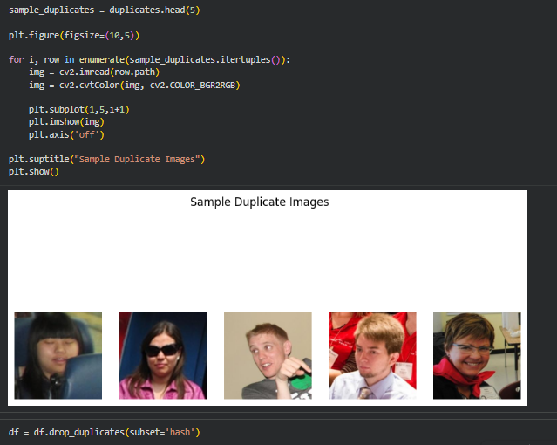
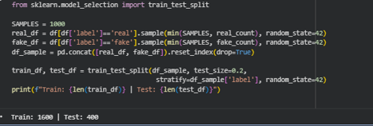
Dataset & Sampling Strategy
Dataset
Source: Kaggle "Deepfake and Real Images" (manjilkarki) 70,001 real and 70,001 fake pre-cropped facial images
Balanced sampling: 500/class for classical ML; 1,000/class for deep learning models
Stratified 80/20 train-test split (random_state=42) to preserve class balance
MD5 hash-based duplicate detection and removal to prevent data leakage
Figure: Sample Duplicate Image Detection
Figure: Train-Test Dataset Split Process
Notes:
The dataset comes from Kaggle and contains over 140,000 real and fake facial images.
For this research, balanced samples will be selected for both classical machine learning and deep learning experiments.
The data will be divided into training and testing sets using an 80-20 stratified split, and duplicate images will be removed using MD5 hashing to avoid data leakage.

Slide 10
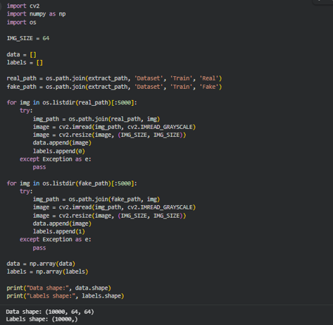
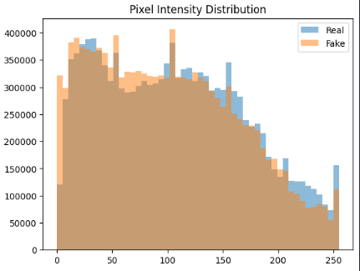
Data Preprocessing
Preparing Images for Analysis
Grayscale loading (OpenCV) - frequency features depend on intensity, not colour
Resizing: 64×64 for classical ML; 128×128 for deep learning
Pixel normalisation (0-1 scaling); ImageNet-specific preprocessing for transfer learning models
Exploratory Data Analysis: pixel intensity statistics, histograms, sample visualisations
Figure: Image Loading and Resizing Process
Figure: Pixel Intensity Distribution
Notes:
Before training, the images undergo several preprocessing steps.
Images are converted to grayscale because frequency analysis relies on intensity values.
They are resized to suitable dimensions, normalised, and explored using basic statistical analysis.
These preprocessing steps ensure consistent input quality for all models.

Slide 11
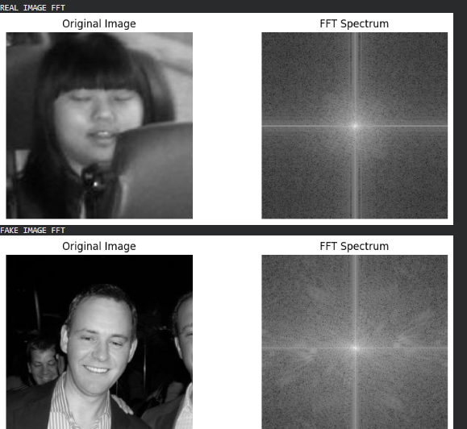
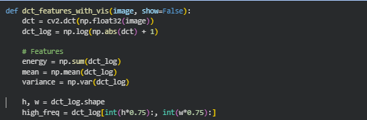
Frequency-Domain Feature Engineering
Core Methodological Innovation
FFT: converts images to frequency domain; extracts spectral energy, mean magnitude, variance, high-frequency ratio
DCT: extracts analogous features from cosine-transformed coefficients (linked to compression artefacts)
Rationale: GAN upsampling creates grid-like high-frequency artefacts invisible in spatial domain but detectable
Figure: FFT Spectrum Analysis of Real and Fake Images
Figure: DCT Feature Extraction Procedure
Notes:
This is the core contribution of the research.
Fast Fourier Transform and Discrete Cosine Transform convert images from the spatial domain into the frequency domain.
From these transformed images, frequency-based features such as spectral energy, magnitude, variance, and high-frequency ratios are extracted.
These features capture hidden artefacts introduced during deepfake generation.

Slide 12
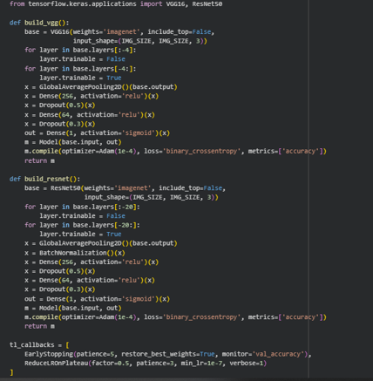
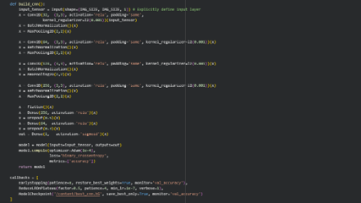
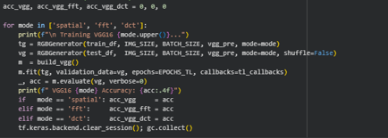
Models: From Baseline to Deep Learning
Model Architectures
Logistic Regression - baseline on 8-D FFT+DCT features
Custom CNN - 4 convolutional blocks (32→256 filters), trained on spatial, FFT, and DCT inputs separately
VGG16 (transfer learning) - last 4 layers fine-tuned; ImageNet pretrained
ResNet50 (transfer learning) - last 20 layers fine-tuned; residual connections for deeper feature extraction
Data augmentation (rotation, flip, zoom, shift) applied to spatial CNN training only
Figure: Transfer Learning Models: VGG16 and ResNet50
Figure: CNN Architecture and Training Setup
Notes:
Four different models will be evaluated.
Logistic Regression provides a simple baseline using handcrafted frequency features.
The Custom CNN learns features directly from transformed images.
VGG16 and ResNet50 use transfer learning with pretrained ImageNet weights to improve classification performance.
Comparing these models helps determine which architecture benefits most from frequency-domain information.

Slide 13
Evaluation & Ethical Considerations
Data Analysis
Metrics: Accuracy (primary, since dataset is balanced), Precision, Recall, F1-score
Confusion matrix special attention to False Negatives (missed deepfakes)
Training and validation curves to check convergence and overfitting
Grouped bar chart comparing all 9 model–input configurations
Ethics
Kaggle dataset contains no personally identifiable information
Research is purely defensive aimed at detecting, not creating, deepfakes
Full, unbiased reporting of all model results
Notes:
Model performance will be evaluated using Accuracy, Precision, Recall, and F1-score.
Confusion matrices will also be analysed, particularly false negatives because missing a deepfake can have serious consequences.
Ethically, this research only uses publicly available datasets and is intended solely for defensive purposes detecting deepfakes rather than creating them.

Slide 14
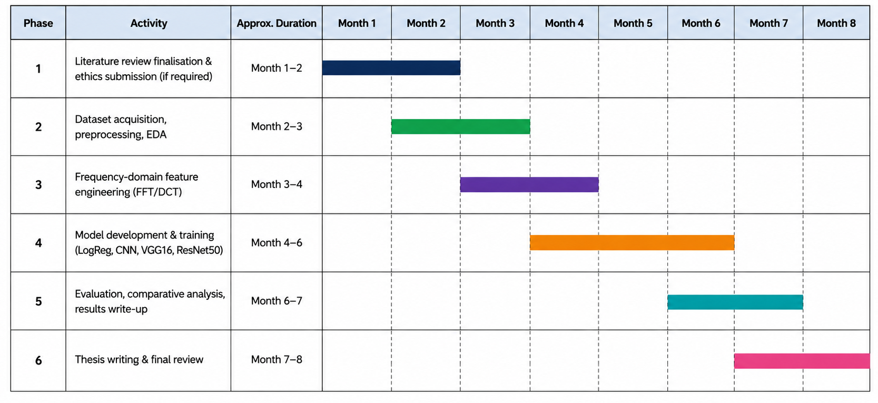
Proposed Project Timeline
Notes:
The project is planned over eight months.
The first two months focus on literature review and ethics approval.
The following months cover dataset preparation, feature engineering, model development, evaluation, and finally thesis writing and review.
This schedule provides sufficient time for each research phase.

Slide 15
Challenges & Support Needs
Anticipated Challenges
Limited dataset scale (1,000 images/class) may constrain generalisability
Single dataset/generation technique no cross-dataset validation
Resolution downscaling (128×128) and grayscale conversion may lose fine artefact detail
No cross-validation or formal significance testing (McNemar/t-test) due to time/compute limits
Colab session/GPU memory limits during sequential model training
Support and Training Needs
Kaggle dataset contains no personally identifiable information
Research is purely defensive aimed at detecting, not creating, deepfakes
Full, unbiased reporting of all model results (no cherry-picking)
Notes:
Some anticipated challenges include limited dataset diversity, reduced image resolution after preprocessing, and computational limitations when training deep learning models on Google Colab.
These limitations will be acknowledged in the research, and all findings will be reported objectively without selective reporting.

Slide 16
References
Pei, G., Zhang, J., Hu, M., Zhang, Z., Wang, C., Wu, Y., Zhai, G., Yang, J., & Tao, D. (2026). Deepfake Generation and Detection: A Benchmark and Survey. ACM Computing Surveys. https://doi.org/10.1145/3801962
Sunil, R., Mer, P., Diwan, A., Mahadeva, R., & Sharma, A. (2025). Exploring autonomous methods for deepfake detection: A detailed survey on techniques and evaluation. Heliyon, 11(3), e42273. https://doi.org/10.1016/j.heliyon.2025.e42273
Sohail, S., Sajjad, S. M., Zafar, A., Iqbal, Z., Muhammad, Z., & Kazim, M. (2025). Deepfake Image Forensics for Privacy Protection and Authenticity Using Deep Learning. Information, 16(4), 270–270. https://doi.org/10.3390/info16040270
GeeksforGeeks (2019). Generative Adversarial Network (GAN). [online] GeeksforGeeks. Available at: https://www.geeksforgeeks.org/deep-learning/generative-adversarial-network-gan/.
Notes:
These are the main references supporting my research, including recent studies on deepfake detection, frequency-domain analysis, and digital image forensics.

Slide 17
THANK YOU
Notes:
Thank you very much for your time and attention.
This concludes my presentation, and I would be happy to answer any questions or receive your feedback.

